Slide 1
Knowledge-Based Agents
UNIT 3

Slide 2
A knowledge-based agent
A knowledge-based agent includes a knowledge base and an inference system.
A knowledge base is a set of representations of facts of the world.
Each individual representation is called a sentence.
The sentences are expressed in a knowledge representation language.
The agent operates as follows:
  1. It TELLs the knowledge base what it perceives.
  2. It ASKs the knowledge base what action it should perform.
  3. It performs the chosen action.

Slide 3
Architecture of a knowledge-based agent
Knowledge Level.
  The most abstract level: describe agent by saying what it knows.
  Example: A taxi agent might know that the Golden Gate Bridge connects San Francisco with the Marin County.
Logical Level.
  The level at which the knowledge is encoded into sentences.
  Example: Links(GoldenGateBridge, SanFrancisco, MarinCounty).
Implementation Level.
  The physical representation of the sentences in the logical level.
  Example: ‘(links goldengatebridge sanfrancisco marincounty)

Slide 4
The Wumpus World environment
The Wumpus computer game
The agent explores a cave consisting of rooms connected by passageways.
Lurking somewhere in the cave is the Wumpus, a beast that eats any agent that enters its room.
Some rooms contain bottomless pits that trap any agent that wanders into the room.
Occasionally, there is a heap of gold in a room.
The goal is to collect the gold and exit the world without being eaten

Slide 5
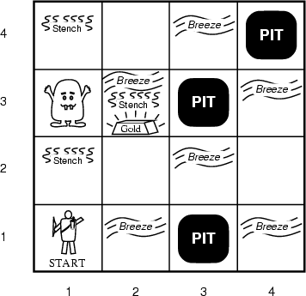
A typical Wumpus world
The agent always starts in the field [1,1].
The task of the agent is to find the gold, return to the field [1,1] and climb out of the cave.

Slide 6
Agent in a Wumpus world: Percepts
The agent perceives
  a stench in the square containing the wumpus and in the adjacent squares (not diagonally)
  a breeze in the squares adjacent to a pit
  a glitter in the square where the gold is
  a bump, if it walks into a wall
  a woeful scream everywhere in the cave, if the wumpus is killed
The percepts are given as a five-symbol list. If there is a stench and a breeze, but no glitter, no bump, and no scream, the percept is
  [Stench, Breeze, None, None, None]

Slide 7
Wumpus world actions
go forward
turn right 90 degrees
turn left 90 degrees
grab: Pick up an object that is in the same square as the agent
shoot: Fire an arrow in a straight line in the direction the agent is facing. The arrow continues until it either hits and kills the wumpus or hits the outer wall. The agent has only one arrow, so only the first Shoot action has any effect
climb is used to leave the cave. This action is only effective in the start square
die: This action automatically and irretrievably happens if the agent enters a square with a pit or a live wumpus

Slide 8
Wumpus goal
The agent’s goal is to find the gold and bring it back to the start square as quickly as possible, without getting killed
  1000 points reward for climbing out of the cave with the gold
  1 point deducted for every action taken
  10000 points penalty for getting killed

Slide 9
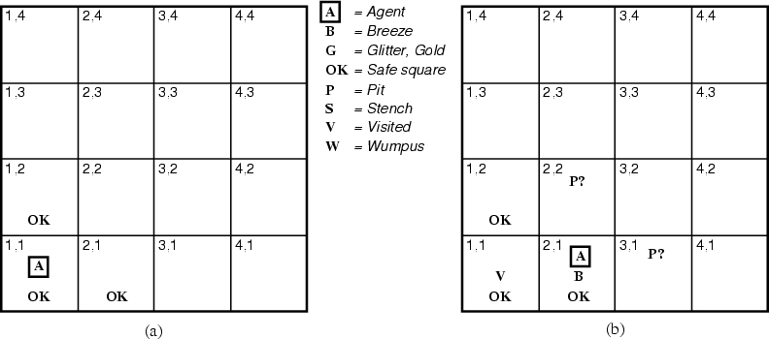
The Wumpus agent’s first step
¬W
¬W

Slide 10
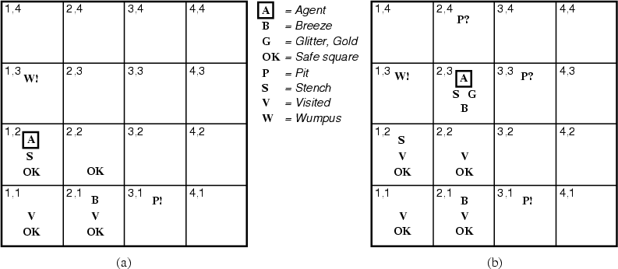
Later
¬W
¬W
¬P
¬P
¬W
¬W

Slide 11
Let’s Play!

Slide 12
Wumpuses online
http://www.cs.berkeley.edu/~russell/code/doc/overview-AGENTS.html – Lisp version from Russell & Norvig
http://scv.bu.edu/htbin/wcl –
Web-based version you can play
http://codenautics.com/wumpus/ –
downloadable Mac version

Slide 13
Representation, reasoning, and logic
The object of knowledge representation is to express knowledge in a computer-tractable form, so that agents can perform well.
A knowledge representation language is defined by:
  its syntax, which defines all possible sequences of symbols that constitute sentences of the language.
    Examples: Sentences in a book, bit patterns in computer memory.
  its semantics, which determines the facts in the world to which the sentences refer.
    Each sentence makes a claim about the world.
    An agent is said to believe a sentence about the world.

Slide 14
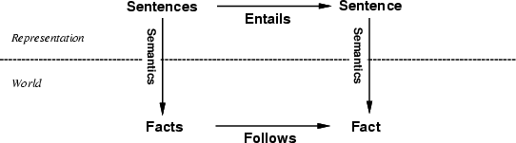
The connection between sentences and facts
Semantics maps sentences in logic to facts in the world.
The property of one fact following from another is mirrored
by the property of one sentence being entailed by another.

Slide 15
Logic as a KR language
Multi-valued
Logic
Modal
Temporal
Non-monotonic
Logic
Higher Order
Probabilistic
Logic
First Order
Propositional Logic
Fuzzy
Logic

Slide 16

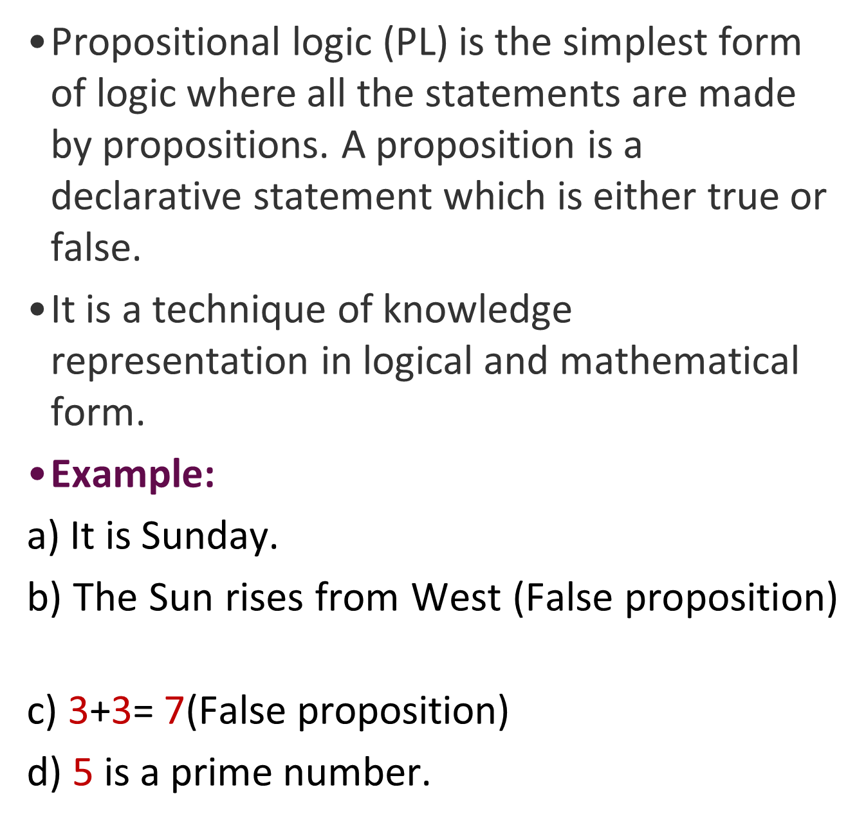

Slide 17
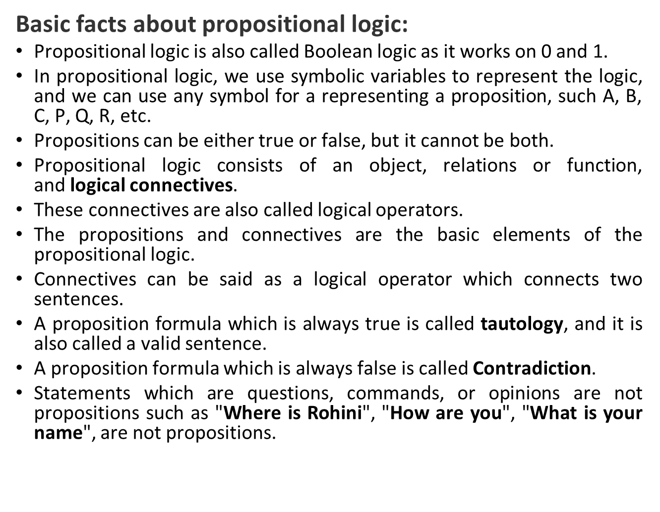

Slide 18
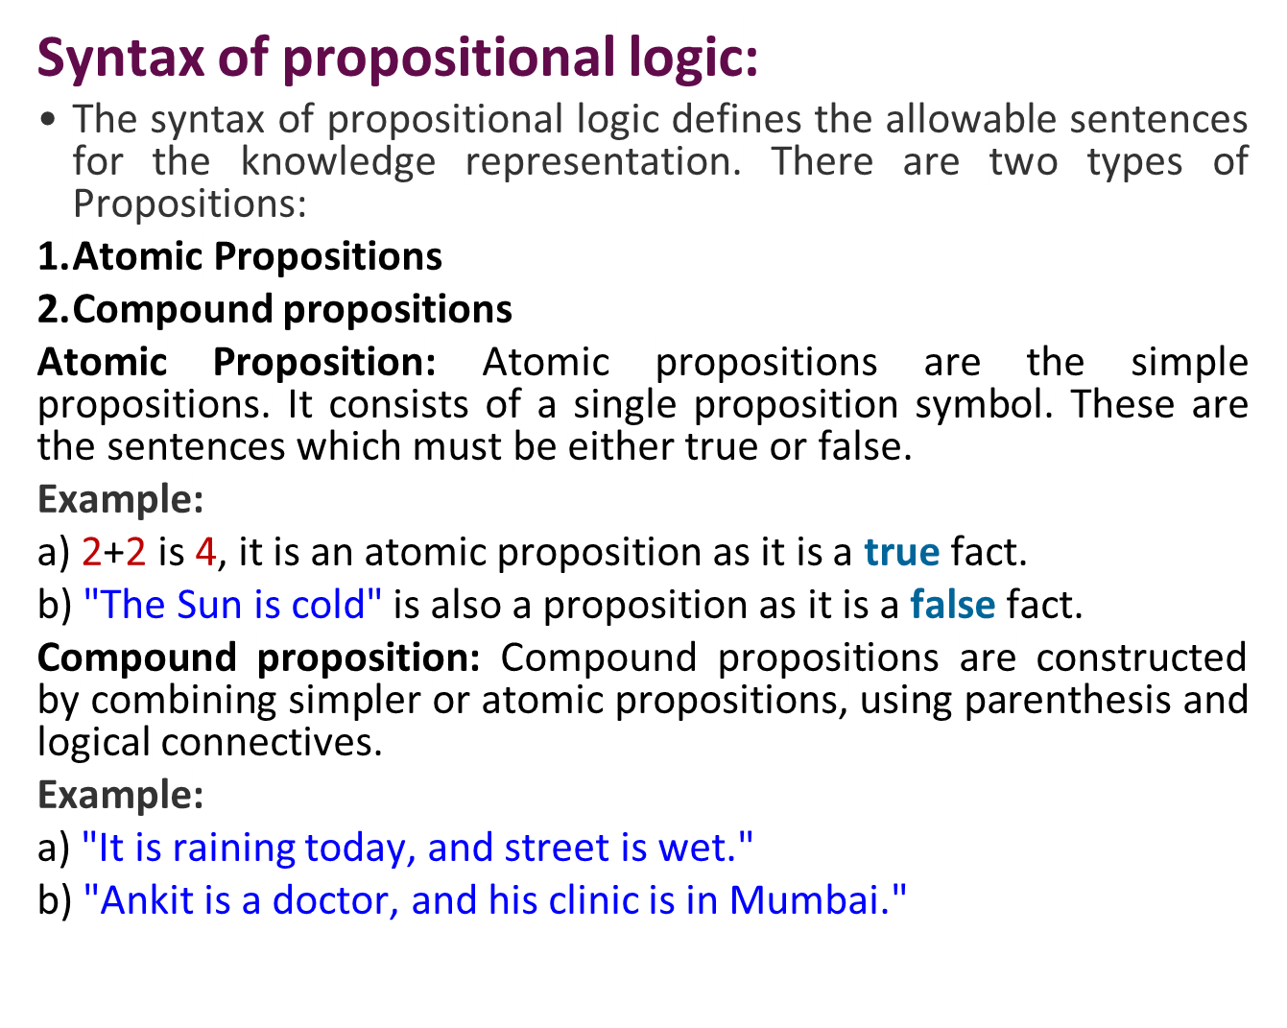

Slide 19
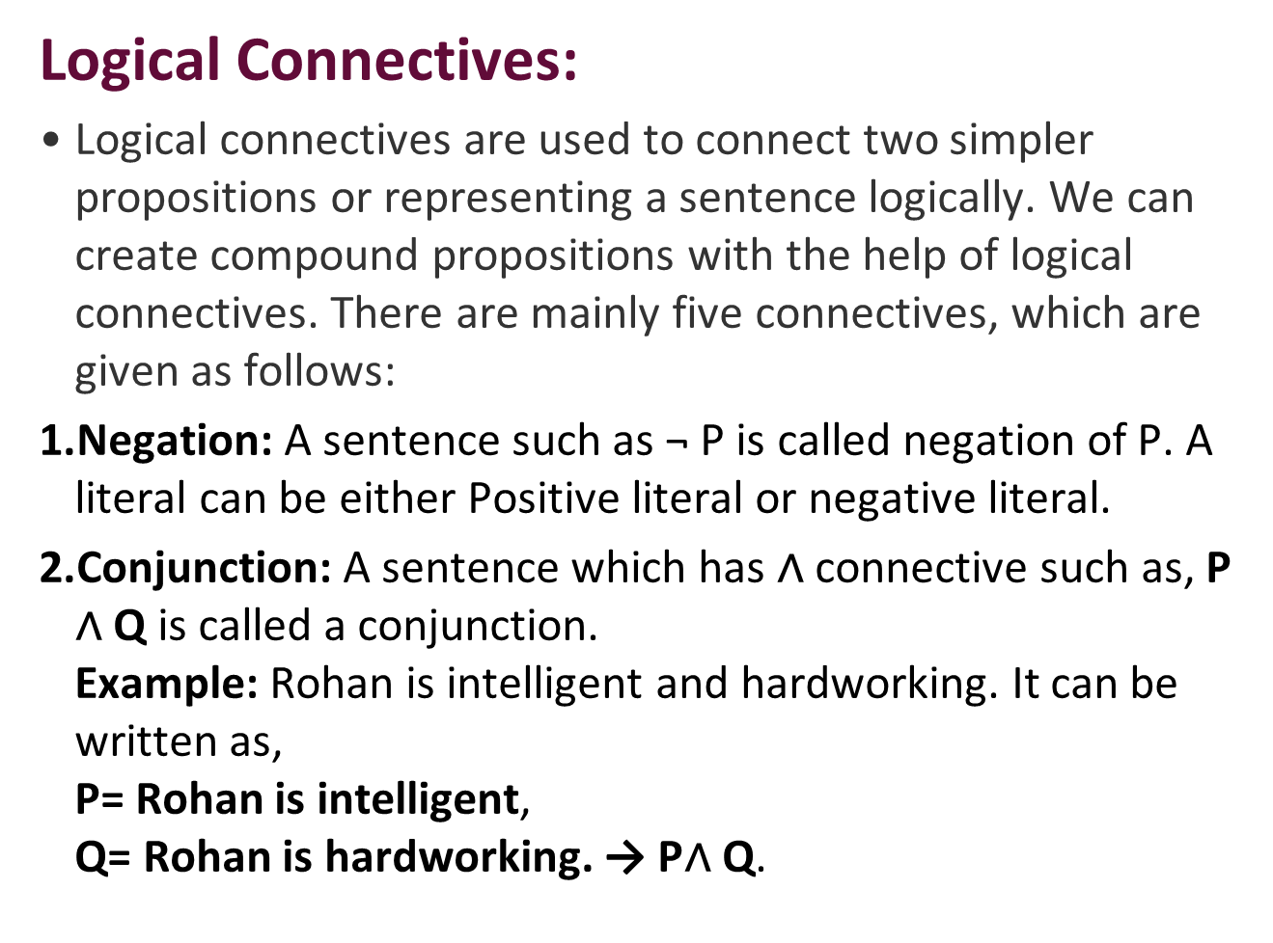

Slide 20
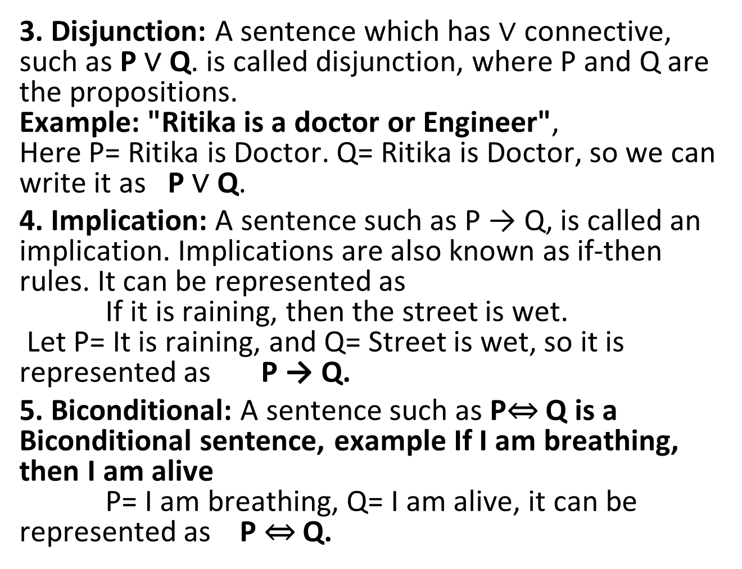

Slide 21
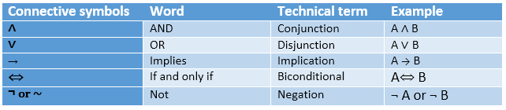

Slide 22

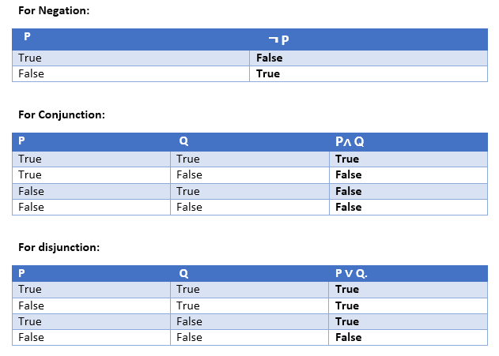

Slide 23
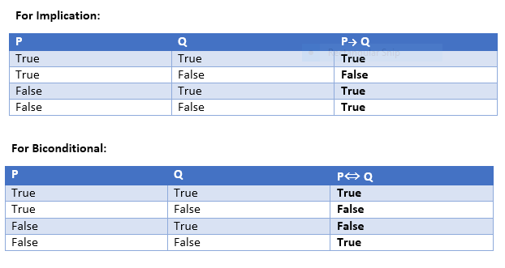

Slide 24
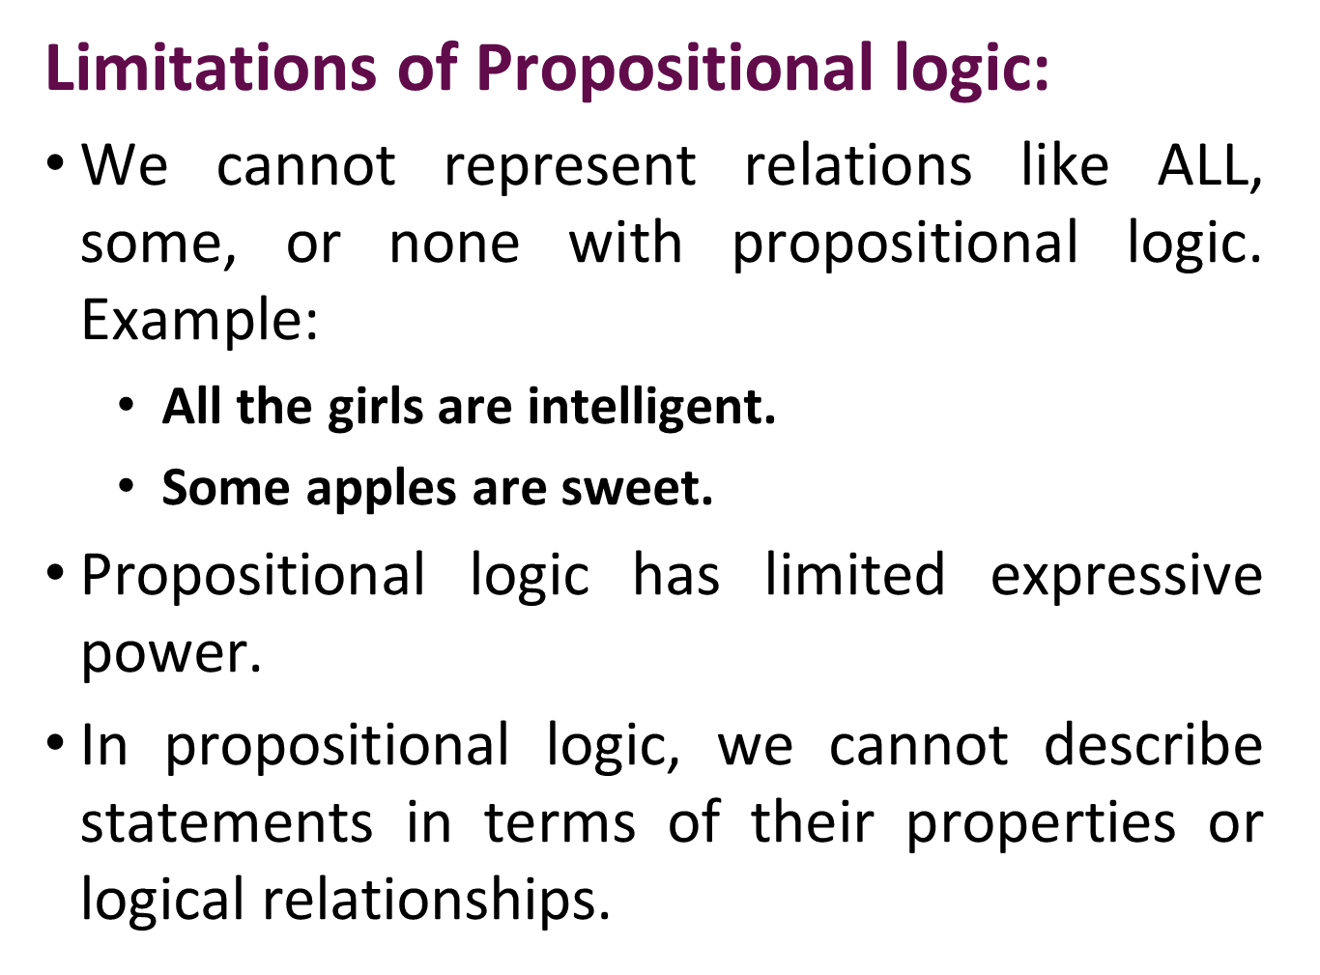

Slide 25

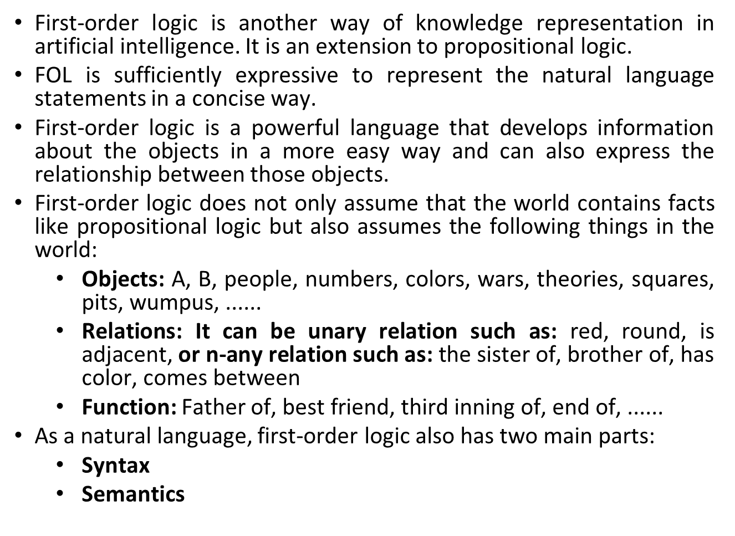

Slide 26
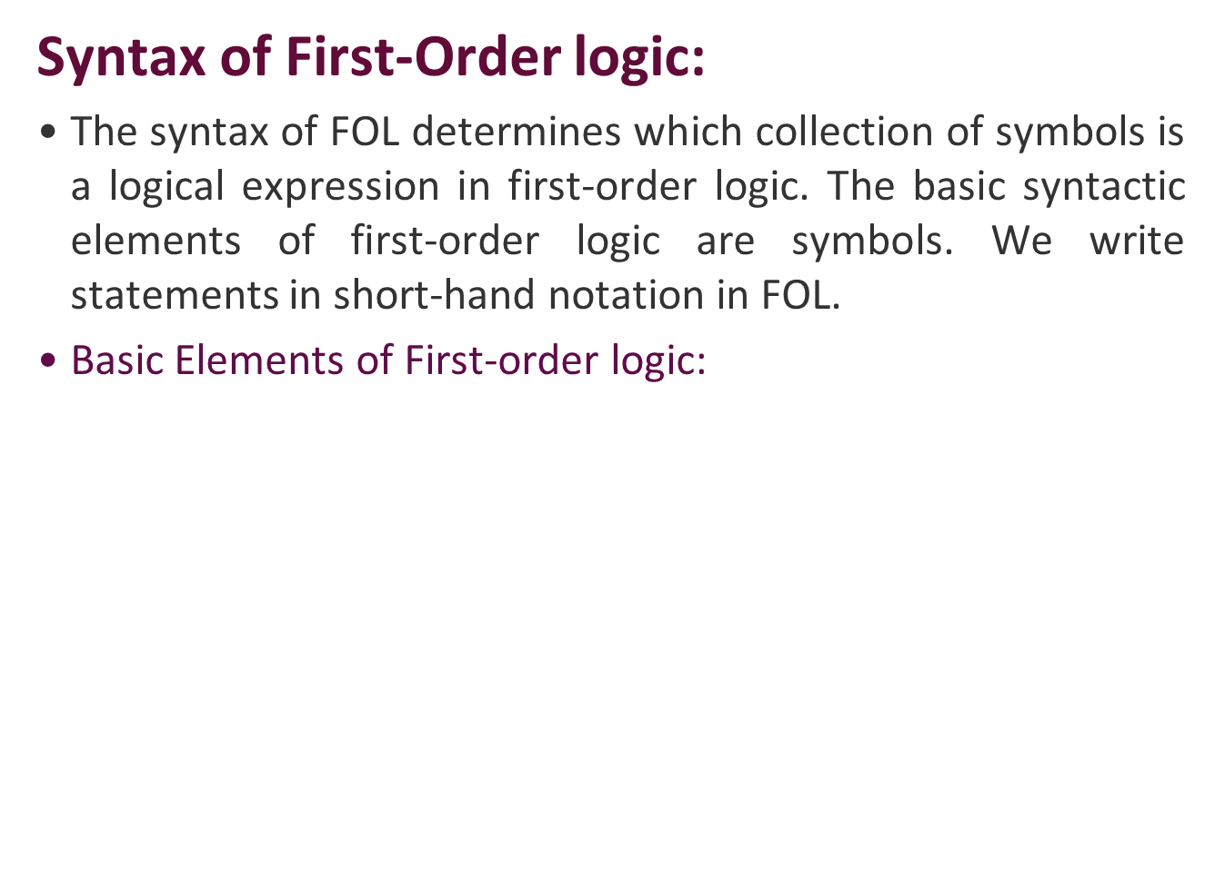
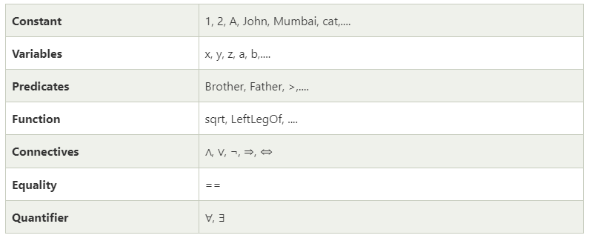

Slide 27
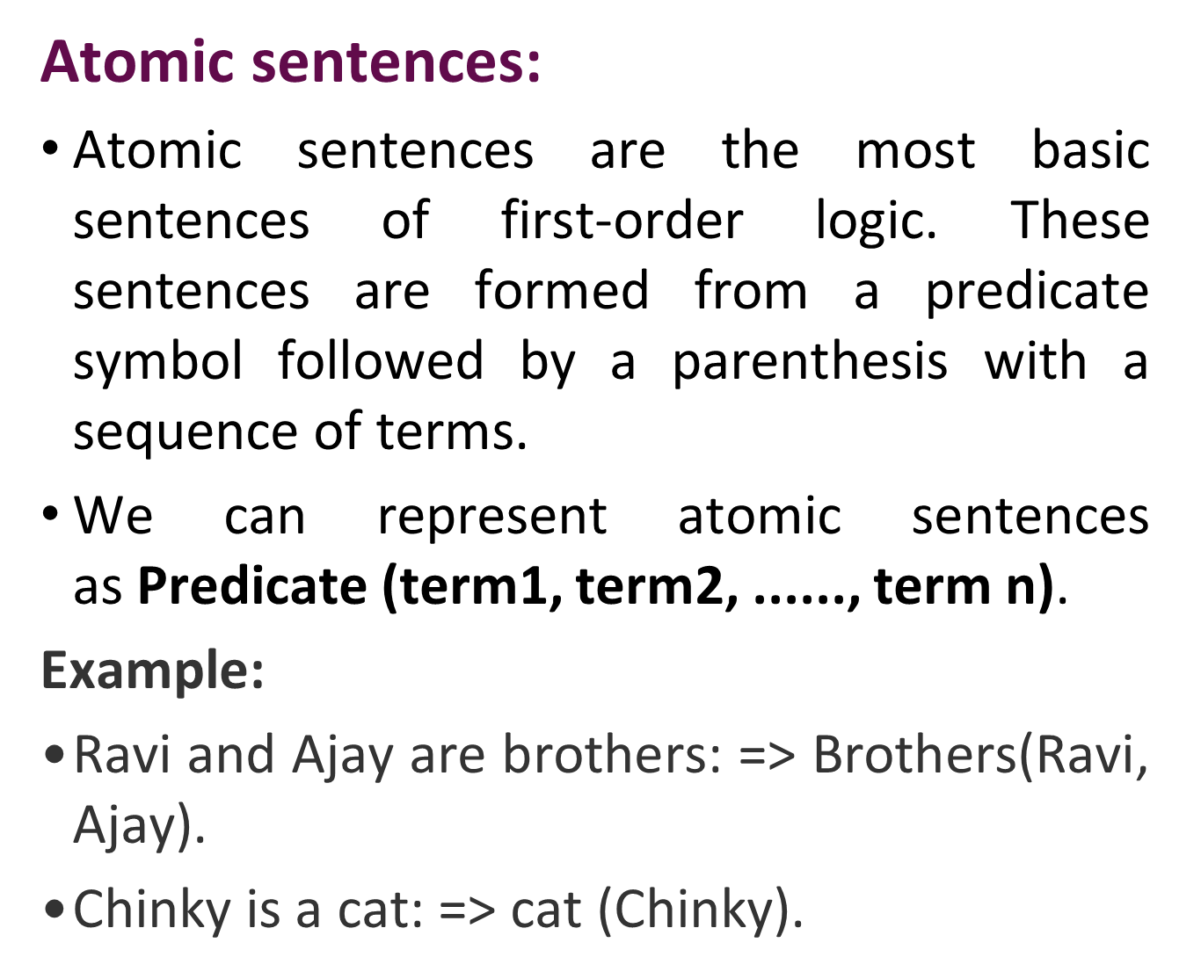

Slide 28
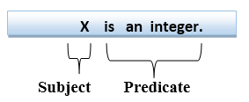
Complex Sentences:
Complex sentences are made by combining atomic sentences using connectives.
First-order logic statements can be divided into two parts:
Subject: Subject is the main part of the statement.
Predicate: A predicate can be defined as a relation, which binds two atoms together in a statement.
Consider the statement: "x is an integer.", it consists of two parts, the first part x is the subject of the statement and second part "is an integer," is known as a predicate.

Slide 29
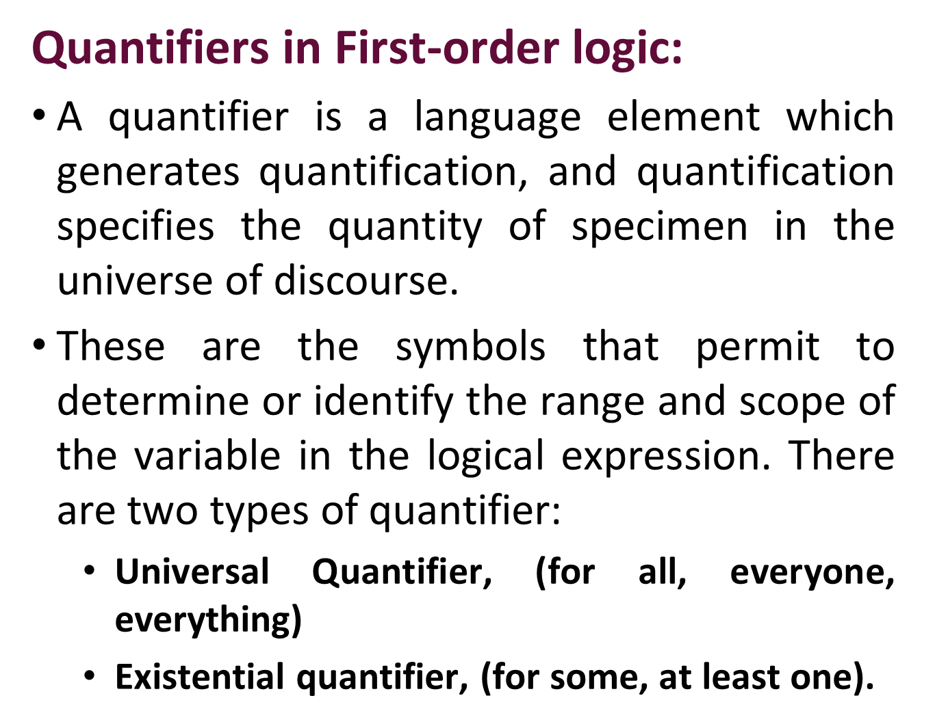

Slide 30
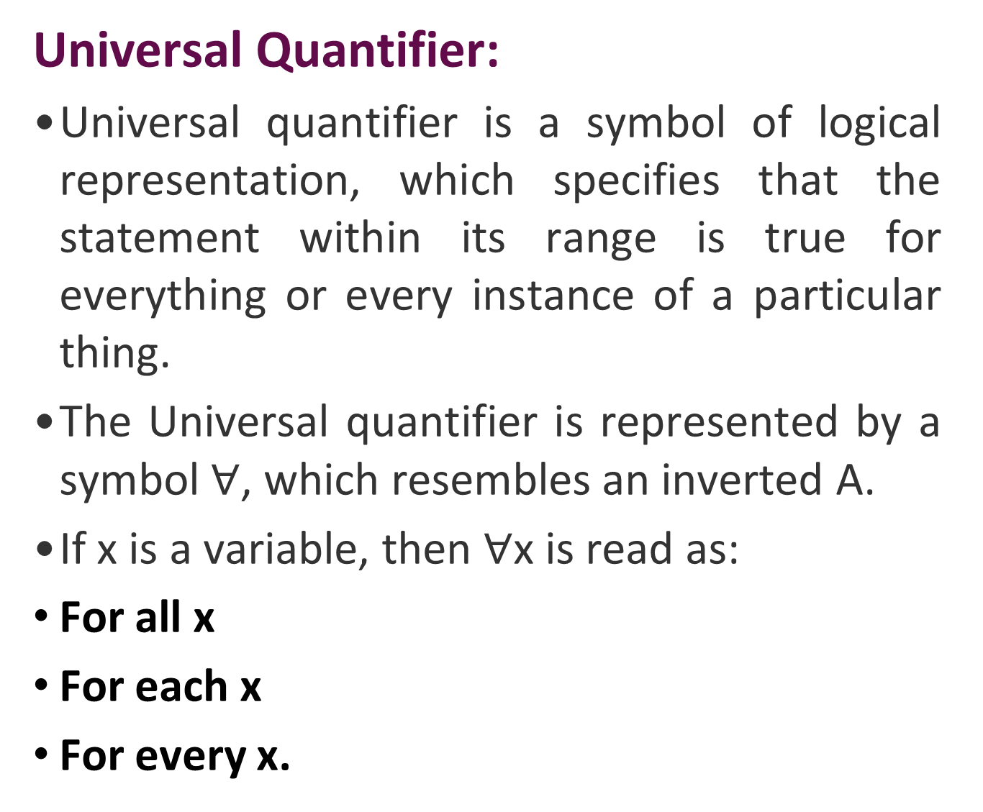

Slide 31
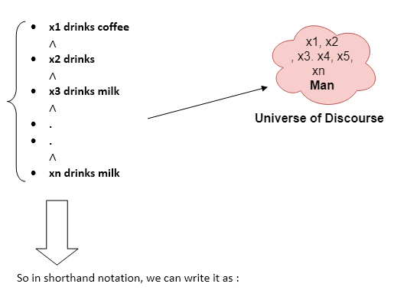
Example:
All man drink coffee.
Let a variable x which refers to a man so all x can be represented as below:
∀x man(x) → drink (x, coffee)
It will be read as: There are all x where x is a man who drink coffee.

Slide 32
Existential Quantifier:
Existential quantifiers express that the statement within its scope is true for at least one instance of something.
It is denoted by the logical operator ∃, which resembles as inverted E. When it is used with a predicate variable then it is called as an existential quantifier.
Note: In Existential quantifier we always use AND or Conjunction symbol (∧).
If x is a variable, then existential quantifier will be ∃x or ∃(x). And it will be read as:
There exists a 'x.'
For some 'x.'
For at least one 'x.'

Slide 33
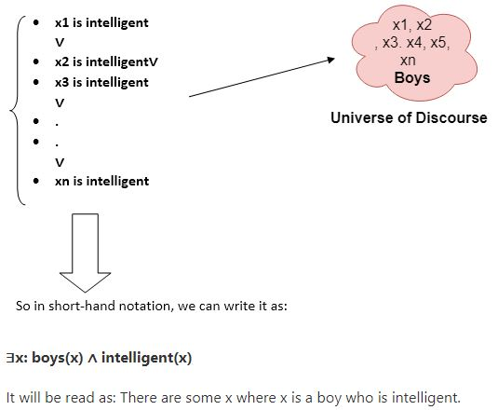
Example:
Some boys are intelligent.

Slide 34
Points to remember:
The main connective for universal quantifier ∀ is implication →.
The main connective for existential quantifier ∃ is and ∧.
Properties of Quantifiers:
In universal quantifier, ∀x∀y is similar to ∀y∀x.
In Existential quantifier, ∃x∃y is similar to ∃y∃x.
∃x∀y is not similar to ∀y∃x.

Slide 35
Some Examples of FOL using quantifier:
1. All birds fly.
In this question the predicate is "fly(bird)."
And since there are all birds who fly so it will be represented as follows.
∀x bird(x) →fly(x).
2. Every man respects his parent.
In this question, the predicate is "respect(x, y)," where x=man, and y= parent.
Since there is every man so will use ∀, and it will be represented as follows:
∀x man(x) → respects (x, parent).

Slide 36
3. Some boys play cricket.
In this question, the predicate is "play(x, y)," where x= boys, and y= game. Since there are some boys so we will use ∃, and it will be represented as:
∃x boys(x) → play(x, cricket).
4. Not all students like both Mathematics and Science.
In this question, the predicate is "like(x, y)," where x= student, and y= subject.
Since there are not all students, so we will use ∀ with negation, so following representation for this:
¬∀ (x) [ student(x) → like(x, Mathematics) ∧ like(x, Science)].
5. Only one student failed in Mathematics.
In this question, the predicate is "failed(x, y)," where x= student, and y= subject.
Since there is only one student who failed in Mathematics, so we will use following representation for this:
∃(x) student(x) → failed (x, Mathematics)

Slide 37
Free and Bound Variables:
The quantifiers interact with variables which appear in a suitable way. There are two types of variables in First-order logic which are given below:
Free Variable:
A variable is said to be a free variable in a formula if it occurs outside the scope of the quantifier.
Example: ∀x ∃(y)[P (x, y, z)], where z is a free variable.
Bound Variable:
A variable is said to be a bound variable in a formula if it occurs within the scope of the quantifier.
Example: ∀x [A (x) B( y)], here x and y are the bound variables.

Slide 38
KNOWLEDGE ENGINEERING
The process of constructing a knowledge-base in first-order logic is called as knowledge- engineering.
In knowledge-engineering, someone who investigates a particular domain, learns important concept of that domain, and generates a formal representation of the objects, is known as knowledge engineer.

Slide 39
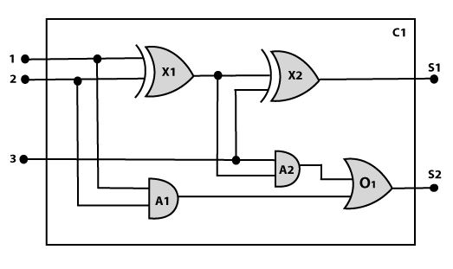
Knowledge-Engineering process:
Identify the task
Assemble the relevant knowledge
Decide on vocabulary
Encode general knowledge about the domain
Encode a description of the problem instance
Pose queries to the inference procedure and get answers
Debug the knowledge base

Slide 40
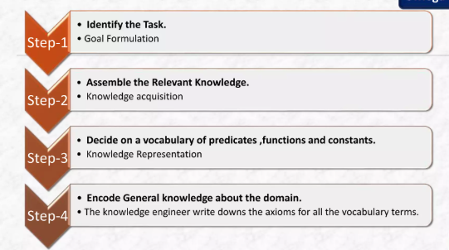


Slide 41
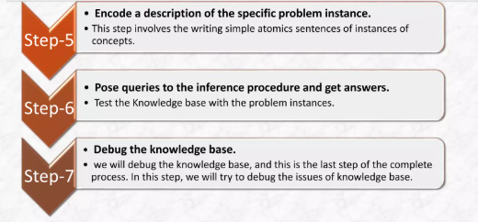

Slide 42
Steps in Circuit Knowledge Engineering
1. Identify the Task: Define the goal, such as analyzing a circuit's functionality (e.g., a one-bit full adder) or identifying feedback loops.
2. Assemble Knowledge: Gather domain knowledge, such as understanding that circuits consist of gates, wires, signals, and terminal connections.
3. Decide on Vocabulary: Choose predicates, functions, and constants to represent components (e.g., Type(X1) = XOR, Connected(Wire1, Gate1, Gate2)).
4. Encode General Knowledge: Define axioms for circuits, such as "a gate output is connected to a wire" or logical rules defining how OR/AND gates behave.
5. Encode Specific Problem Instance: Formulate a specific circuit diagram or problem instance (e.g., a specific configuration of a circuit) using the established vocabulary.
6. Pose Queries: Use an inference engine to query the knowledge base, such as asking if a specific input produces the correct output or where a fault exists.
7. Debug Knowledge Base: Test and rectify errors in the rules or assertions, iterating until the AI correctly interprets the circuit behavior.
This process transforms human expertise into formalized, executable logic (often First-Order Logic), enabling AI to analyze, simulate, and optimize circuit designs.

Slide 43
Inference in First-Order Logic
Inference in First-Order Logic is used to deduce new facts or sentences from existing sentences.
Before understanding the FOL inference rule, let's understand some basic terminologies used in FOL.
Substitution:
Substitution is a fundamental operation performed on terms and formulas.
It occurs in all inference systems in first-order logic.
The substitution is complex in the presence of quantifiers in FOL.
If we write F[a/x], so it refers to substitute a constant "a" in place of variable "x".

Slide 44
Equality:
First-Order logic does not only use predicate and terms for making atomic sentences but also uses another way, which is equality in FOL. For this, we can use equality symbols which specify that the two terms refer to the same object.
Example: Brother (John) = Smith.
As in the above example, the object referred by the Brother (John) is similar to the object referred by Smith.
The equality symbol can also be used with negation to represent that two terms are not the same objects.
Example: ￢(x=y) which is equivalent to x ≠y.

Slide 45
FOL Inference Rules for quantifier:
Universal Generalization
Universal Instantiation
Existential Instantiation
Existential introduction

Slide 46

Universal Generalization:
Universal generalization is a valid inference rule which states that if premise P(c) is true for any arbitrary element c in the universe of discourse, then we can have a conclusion as ∀ x P(x).
It can be represented as:
This rule can be used if we want to show that every element has a similar property.
In this rule, x must not appear as a free variable.
Example: Let's represent, P(c): "A byte contains 8 bits", so for ∀ x P(x) "All bytes contain 8 bits.", it will also be true.

Slide 47

Universal Instantiation
Universal instantiation is also called as universal elimination. It can be applied multiple times to add new sentences.
The new KB is logically equivalent to the previous KB.
As per UI, we can infer any sentence obtained by substituting a ground term for the variable.
The UI rule state that we can infer any sentence P(c) by substituting a ground term c (a constant within domain x) from ∀ x P(x) for any object in the universe of discourse.
It can be represented as:
Example:
IF "Every person like ice-cream"=> ∀x P(x) so we can infer that "John likes ice-cream" => P(c)

Slide 48

Existential Instantiation
Existential instantiation is also called as Existential Elimination.
It can be applied only once to replace the existential sentence.
The new KB is not logically equivalent to old KB, but it will be satisfiable if old KB was satisfiable.
This rule states that one can infer P(c) from the formula given in the form of ∃x P(x) for a new constant symbol c.
The restriction with this rule is that c used in the rule must be a new term for which P(c ) is true.
It can be represented as:

Slide 49
Example:
From the given sentence: ∃x Crown(x) ∧ OnHead(x, John),
So we can infer: Crown(K) ∧ OnHead( K, John), as long as K does not appear in the knowledge base.
The above used K is a constant symbol, which is called Skolem constant.
The Existential instantiation is a special case of Skolemization process.

Slide 50
Existential Introduction
An existential introduction is also known as an existential generalization.
This rule states that if there is some element c in the universe of discourse which has a property P, then we can infer that there exists something in the universe which has the property P.
It can be represented as:
Example:
From the given sentence: "Priyanka got good marks in English."
So we can infer: "someone got good marks in English."

Slide 51
Unification and Lifting
Unification is a process of making two different logical atomic expressions identical by finding a substitution. Unification depends on the substitution process.
It takes two literals as input and makes them identical using substitution.
Let Ψ₁ and Ψ₂ be two atomic sentences and 𝜎 be a unifier such that, Ψ₁𝜎 = Ψ₂𝜎, then it can be expressed as UNIFY(Ψ₁, Ψ₂).
Example: Find MGU for Unify{King(x), King(John)}
Let Ψ₁ = King(x), Ψ₂ = King(John),

Slide 52
Substitution θ = {John/x} is a unifier for these atoms and applying this substitution, and both expressions will be identical.
The UNIFY algorithm is used for unification, which takes two atomic sentences and returns a unifier for those sentences (If any exist).
Unification is a key component of all first-order inference algorithms.
It returns fail if the expressions do not match with each other.
The substitution variables are called Most General Unifier or MGU.

Slide 53
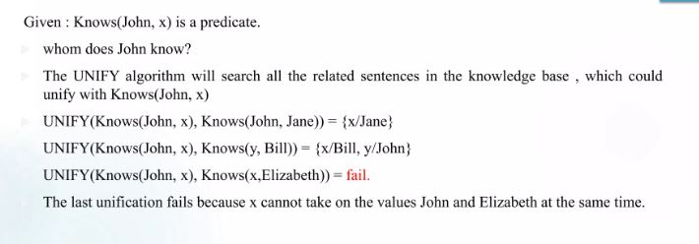

Slide 54
Conditions for Unification
A variable can be swapped for a constant or another variable. For example, we can unify P(x, B) and P(A, y) by assigning x to A and y to B.
A variable cannot be replaced with an expression containing itself. It is impossible to unify x with f(x) because it would create a cycle, and therefore, unification is not possible.
If the same variable occurs twice in different places in an expression, unification fails. For instance, P(x, x) and P(A, B) cannot be unified since x cannot simultaneously be A and B.

Slide 55
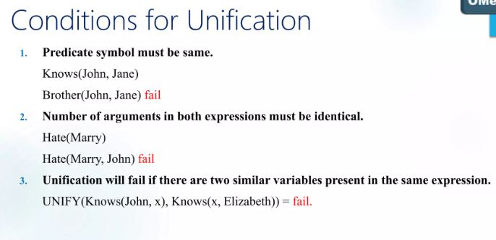

Slide 56
Forward and backward chaining
Inference engine:
The inference engine is the component of the intelligent system in artificial intelligence, which applies logical rules to the knowledge base to infer new information from known facts.
The first inference engine was part of the expert system. Inference engine commonly proceeds in two modes, which are:
Forward chaining
Backward chaining

Slide 57
Forward chaining
Forward chaining is also known as a forward deduction or forward reasoning method when using an inference engine.
Forward chaining is a form of reasoning which start with atomic sentences in the knowledge base and applies inference rules (Modus Ponens) in the forward direction to extract more data until a goal is reached.
The Forward-chaining algorithm starts from known facts, triggers all rules whose premises are satisfied, and add their conclusion to the known facts. This process repeats until the problem is solved.

Slide 58
Properties of Forward-Chaining:
It is a down-up approach, as it moves from bottom to top.
It is a process of making a conclusion based on known facts or data, by starting from the initial state and reaches the goal state.
Forward-chaining approach is also called as data-driven as we reach to the goal using available data.
Forward -chaining approach is commonly used in the expert system, such as CLIPS, business, and production rule systems.

Slide 59
Example:
"As per the law, it is a crime for an American to sell weapons to hostile nations. Country A, an enemy of America, has some missiles, and all the missiles were sold to it by Robert, who is an American citizen."
Prove that "Robert is criminal."
To solve the above problem, first, we will convert all the above facts into first-order definite clauses, and then we will use a forward-chaining algorithm to reach the goal.

Slide 60
Facts Conversion into FOL:
It is a crime for an American to sell weapons to hostile nations. (Let's say p, q, and r are variables)
American (p) ∧ weapon(q) ∧ sells (p, q, r) ∧ hostile(r) → Criminal(p) ...(1)
Country A has some missiles. ?p Owns(A, p) ∧ Missile(p). It can be written in two definite clauses by using Existential Instantiation, introducing new Constant T1.
Owns(A, T1) ......(2)
Missile(T1) .......(3)
All of the missiles were sold to country A by Robert.
?p Missiles(p) ∧ Owns (A, p) → Sells (Robert, p, A) ......(4)

Slide 61
Missiles are weapons.
Missile(p) → Weapons (p) .......(5)
Enemy of America is known as hostile.
Enemy(p, America) →Hostile(p) ........(6)
Country A is an enemy of America.
Enemy (A, America) .........(7)
Robert is American
American(Robert). ..........(8)

Slide 62

Forward chaining proof:
Step-1:
In the first step we will start with the known facts and will choose the sentences which do not have implications, such as: American(Robert), Enemy(A, America), Owns(A, T1), and Missile(T1). All these facts will be represented as below.

Slide 63
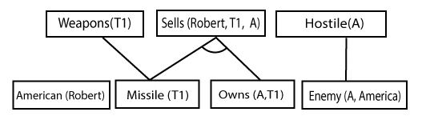
Step-2:
At the second step, we will see those facts which infer from available facts and with satisfied premises.
Rule-(1) does not satisfy premises, so it will not be added in the first iteration.
Rule-(2) and (3) are already added.
Rule-(4) satisfy with the substitution {p/T1}, so Sells (Robert, T1, A) is added, which infers from the conjunction of Rule (2) and (3).
Rule-(6) is satisfied with the substitution(p/A), so Hostile(A) is added and which infers from Rule-(7).

Slide 64
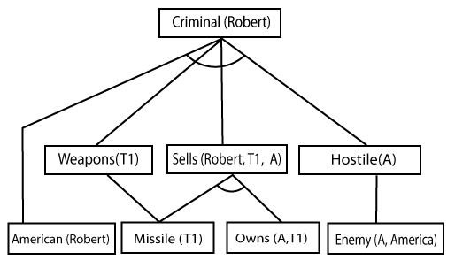
Step 3:
At step-3, as we can check Rule-(1) is satisfied with the substitution {p/Robert, q/T1, r/A}, so we can add Criminal(Robert) which infers all the available facts. And hence we reached our goal statement.
Hence it is proved that Robert is Criminal using forward chaining approach.

Slide 65
Backward Chaining
Backward-chaining is also known as a backward deduction or backward reasoning method when using an inference engine.
A backward chaining algorithm is a form of reasoning, which starts with the goal and works backward, chaining through rules to find known facts that support the goal.
Link : https://www.javatpoint.com/forward-chaining-and-backward-chaining-in-ai

Slide 66
Properties of backward chaining:
It is known as a top-down approach.
Backward-chaining is based on modus ponens inference rule.
In backward chaining, the goal is broken into sub-goal or sub-goals to prove the facts true.
It is called a goal-driven approach, as a list of goals decides which rules are selected and used.
Backward -chaining algorithm is used in game theory, automated theorem proving tools, inference engines, proof assistants, and various AI applications.
The backward-chaining method mostly used a depth-first search strategy for proof.

Slide 67
Learning Agents
A learning agent in AI is the type of agent that can learn from its past experiences or it has learning capabilities. It starts to act with basic knowledge and then is able to act and adapt automatically through learning. It has four components such as,
Learning element: It is responsible for making improvements by learning from the environment
Critic: The learning element takes feedback from critics which describe how well the agent is doing with respect to a fixed performance standard.
Performance element: It is responsible for selecting external action
Problem Generator: This component is responsible for suggesting actions that will lead to new and informative experiences.

Slide 68
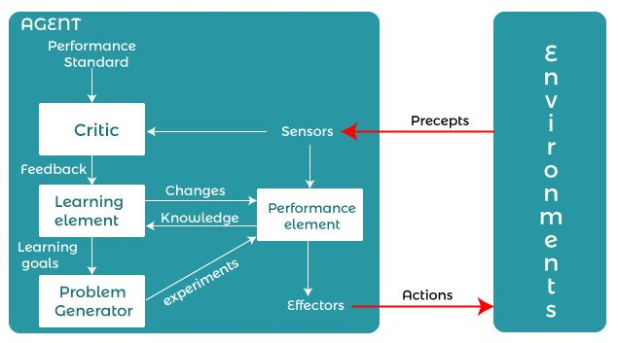

Slide 69
Different forms of learning
In artificial intelligence, various forms of learning enable machines to acquire knowledge and improve their performance over time. Here are some of the different forms of learning in AI:
Supervised Learning
Unsupervised Learning
Semi-Supervised Learning
Reinforcement Learning
Deep Learning
Transfer Learning
Online Learning

Slide 70
Supervised Learning: In supervised learning, the model is trained on a labeled dataset, where each input is paired with the corresponding correct output. The model learns to map inputs to outputs based on the labeled examples provided during training.
Unsupervised Learning: Unsupervised learning involves training models on unlabeled data, where the algorithm tries to find hidden patterns or structures within the data. It doesn't have predefined target outputs; instead, it seeks to discover the underlying distribution or relationships among the input features.
Semi-Supervised Learning: Semi-supervised learning is a combination of supervised and unsupervised learning. It leverages a small amount of labeled data along with a larger amount of unlabeled data to train models. This approach can be particularly useful when obtaining labeled data is expensive or time-consuming.

Slide 71
Reinforcement Learning: Reinforcement learning is a type of learning where an agent learns to interact with an environment by taking actions and receiving feedback in the form of rewards or penalties. The agent aims to maximize cumulative rewards over time by learning which actions lead to favorable outcomes. It involves learning through trial and error, exploration, and exploitation of the environment.
Deep Learning: Deep learning is a subset of machine learning that uses artificial neural networks with multiple layers (deep architectures) to learn complex patterns from data. Deep learning models have shown remarkable success in various tasks such as image recognition, natural language processing, and speech recognition.

Slide 72
Transfer Learning: Transfer learning involves transferring knowledge from one task or domain to another. Instead of training a model from scratch for a specific task, pre-trained models are fine-tuned or adapted to new tasks with relatively smaller datasets. Transfer learning can accelerate the training process and improve performance, especially when data is limited.
Online Learning: Online learning, also known as incremental learning or lifelong learning, involves updating a model continuously as new data becomes available. Models learn from individual data instances or mini-batches in an online fashion, without requiring access to the entire dataset at once. This approach is well-suited for scenarios where data streams in real-time or where the data distribution changes over time.

